Slide 1




PropInsight
Smart Reports, Smarter Insights.
Transforming property analysis with intelligent reporting solutions. Gain a competitive edge with data-driven insights for informed decision-making.

Slide 2

The Need for Smart Reports
Time-Consuming
Prone to Errors
Manual report generation is a tedious process, taking hours to complete.
Human error is inevitable, leading to inaccurate reports.

Slide 3

PropInsight's Solution
1
Automated Reports
Generate detailed reports with minimal effort, saving time and resources.
2
AI-powered Insights
Leverage AI technology to enhance accuracy and efficiency.

Slide 4
PropInsight Architecture
Frontend
Backend
User-friendly web interface built with HTML, CSS, and JavaScript.
Powerful FastAPI backend powered by Python, processing data and generating reports.
Data Handling
PDF Generation
API-based report generation, potentially integrating AI for enhanced accuracy.
Efficient PDF generation leveraging JavaScript libraries like html2canvas and jspdf.

Slide 5

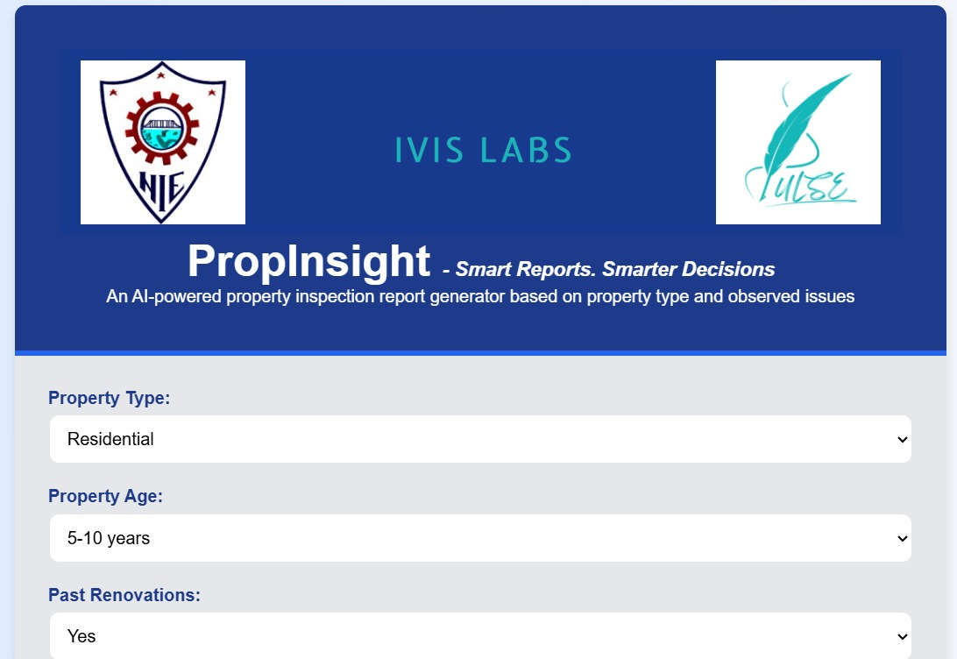
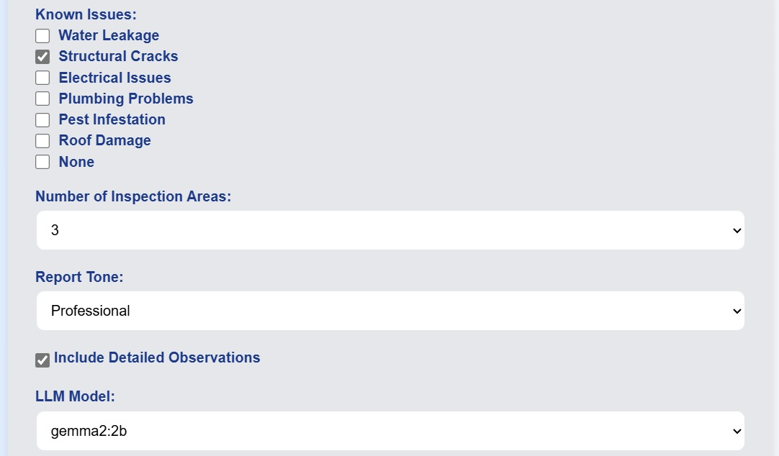



Key Features
User Interface
Standardized Checklists
Automated Reports
Intuitive web interface with dropdowns, forms, and clear navigation.
Pre-defined checklists tailored to different property types for comprehensive inspections.
Effortlessly generate professional PDF reports with customizable layouts and data.

Slide 6
Simplified Workflow
1
Property Type Selection
Choose the property type from a predefined list.
2
Issue Input
Enter observations and details about identified issues.
3
Report Generation
PropInsight automatically generates a structured inspection report.
4
Report Export
Download the report in PDF format for easy sharing and archiving.

Slide 7
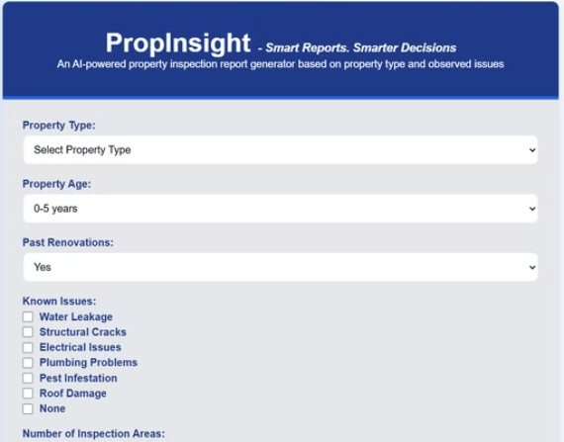
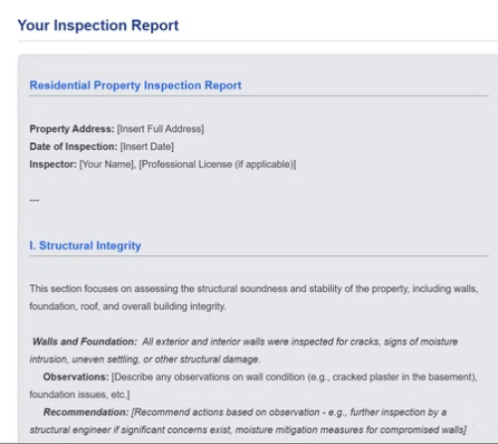
PropInsight in Action
Homepage Report View

Slide 8

Technologies at Play
1
2
Frontend
Backend
HTML, CSS, JavaScript.
Python (FastAPI).
3
4
Libraries
Deployment
Jinja2, html2canvas, jspdf.
Cloud hosting for scalable and secure access.

Slide 9



Overcoming Challenges
Diverse Property Types
PropInsight handles multiple property types with dedicated checklists.
Report Accuracy
AI integration and predefined templates ensure accurate and consistent reports.

Slide 10
Looking Ahead
Database Integration
1
Store and retrieve past reports for analysis and historical data.
AI Issue Detection
2
Implement AI-based automatic issue detection using computer vision.
Mobile Optimization
3
Make PropInsight accessible on all devices for increased convenience.

Slide 11

Team Members
4NI22CI022 G Yashita
4NI22CI024 Harshavardhan S Patil
4NI22CI025 Hrudhay Girish
4NI22CI026 Inchara G Hegde
4NI22CI027 Irshita Saanchi

